Slide 1

PREDICTING CUSTOMER BOOKING BEHAVIOUR – SUMMARY
Jashwanth G

Slide 2
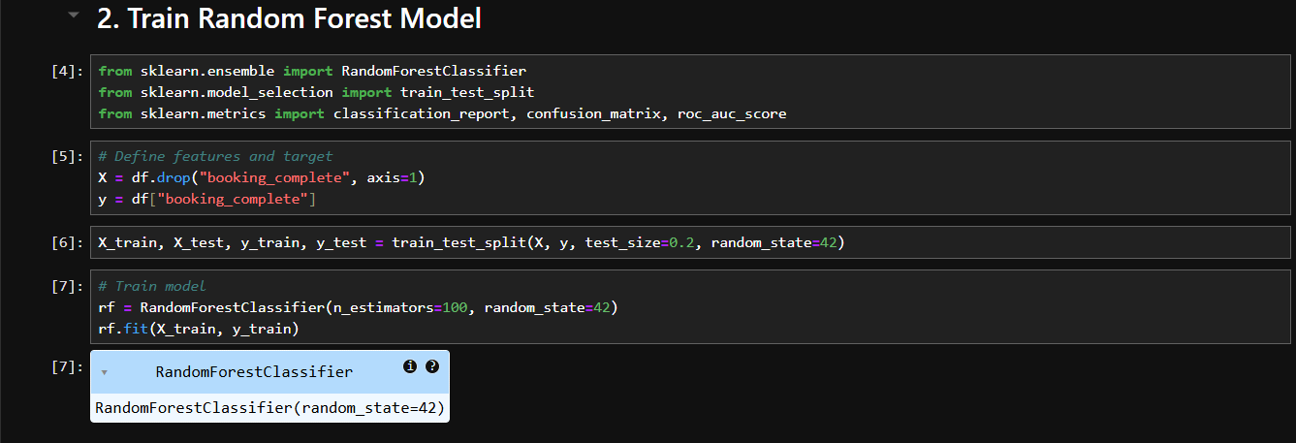
📊 MODEL OVERVIEW
Model Used: Random Forest Classifier
Dataset Size: 50,000 records
Target: Booking Completion (booking_complete)
Jashwanth G

Slide 3
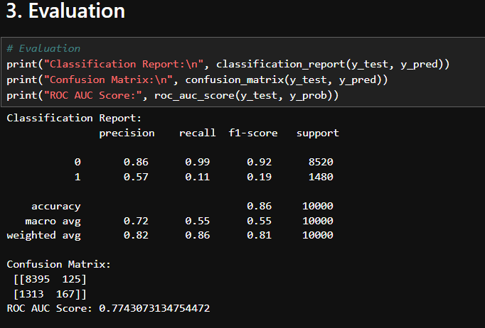
📈 PERFORMANCE METRICS
Accuracy: 86%
F1 Score (for buyers): 0.19
ROC AUC: 0.77
Jashwanth G

Slide 4
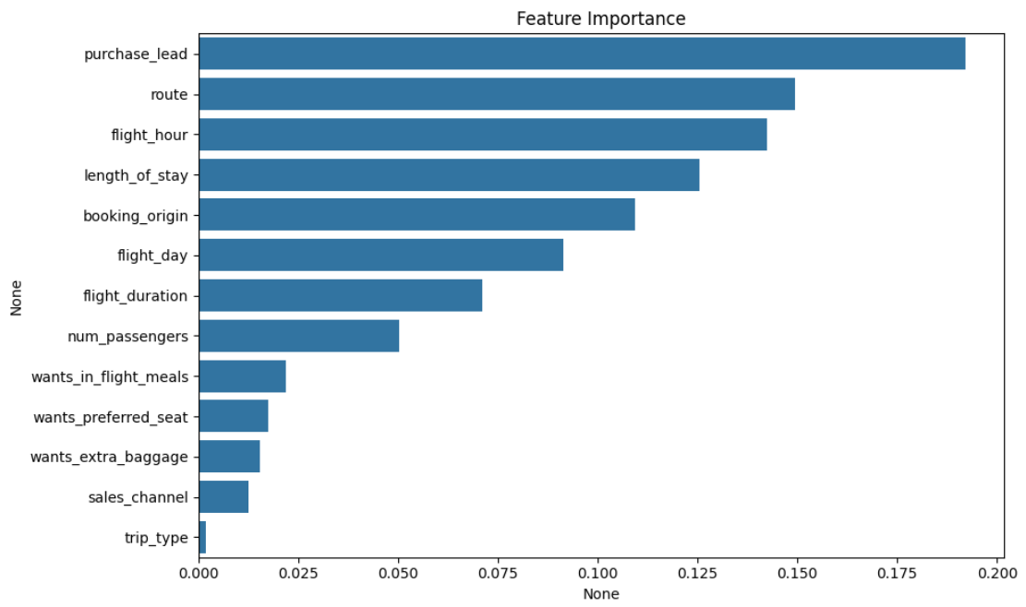
Jashwanth G

Slide 5
🔍 KEY PREDICTIVE FEATURE
flight_hour (Time of departure) was the most important factor
→ Indicates certain departure times are more attractive to likely bookers
💡 BUSINESS INSIGHTS
Model predicts non-bookers well, but struggles with buyers (class imbalance)
Still useful for pre-targeting campaigns based on travel patterns (e.g., peak hours)
Recommend improving buyer prediction with additional behavioral data (e.g., web activity)
Jashwanth G

